Slide 1
A for Artificial Intelligence
Kishan Dasari
April 18th, 2020

Slide 2
Contents
Introduction to Artificial Intelligence
What is it?
History of Artificial Intelligence
Who started it? When did it happen? Where did it happen?
Importance of Artificial Intelligence
Why do we need it?
Branches of Artificial Intelligence
Machine Learning
Computer Vision
Natural Language Processing

Slide 3
Introduction to Artificial Intelligence
Artificial - Made or produced by human beings
Intelligence - Ability to acquire and apply knowledge and skills
The theory and development of computer systems able to perform tasks that normally require human intelligence.
Visual perception or Computer Vision
Speech recognition or Natural Language Processing
Decision-making
Translating between languages or Machine Translation
Machines ability to learn and solve a problem like a human

Slide 4
History of Artificial Intelligence
1943
Warren McCulloch and Walter Pitts laid foundations for neural networks in Chicago, USA
1950
Alan Turing published “Computing Machinery and Intelligence” in England.
1956
John McCarthy invented LISP programming language for AI.
1959
Arthur Samuel wrote the first computer learning program. The program was the game of checkers, and the IBM computer improved at the game the more it played, studying which moves made up winning strategies and incorporating those moves into its program.

Slide 5
History of Artificial Intelligence
1957
Frank Rosenblatt designed the first neural network for computers – Perceptron, which can simulate the thought processes of the human brain.
1967
The “nearest neighbor” algorithm was written, allowing computers to begin using very basic pattern recognition.
1981
Gerald Dejong introduces the concept of Explanation Based Learning (EBL), in which a computer analyses training data and creates a general rule it can follow by discarding unimportant data.

Slide 6
History of Artificial Intelligence
1996–1997
The Deep Blue Chess Program beats the then world chess champion, Garry Kasparov.
2006
Geoffrey Hinton coins the term “Deep Learning” to explain new algorithms that let computers “see” and distinguish objects and text in images and videos.
2010 - 2020
IBM Watson, Microsoft’s Kinect, Apple’s Siri, Amazon’s Alexa, Google’s AlphaGo, Google TensorFlow, Scikit Learn, Spark MLlib, Amazon Machine Learning, Azure ML

Slide 7
Importance of Artificial Intelligence
Make something better
Healthcare
Agriculture
Make something easier
Information Retrieval
Self-driving Cars
Make something faster
Automation
Finance
Make something harder
Gaming

Slide 8
Branches of Artificial Intelligence
Knowledge Representation
Logical Reasoning
Machine Learning
Natural Language Processing
Perception/Computer Vision
Planning
Robotics

Slide 9
Machine Learning
Machine’s ability to learn without being explicitly programmed.
Supervised Learning
Get inference from the labeled data – a data set which consists of both inputs (features) and their corresponding output(labels).
Unsupervised Learning
Derive structure from unlabeled data – a data set which only has input values.
Semi-supervised Learning
Analyze a mixture of labeled and unlabeled data with high proportions of unlabeled data.

Slide 10
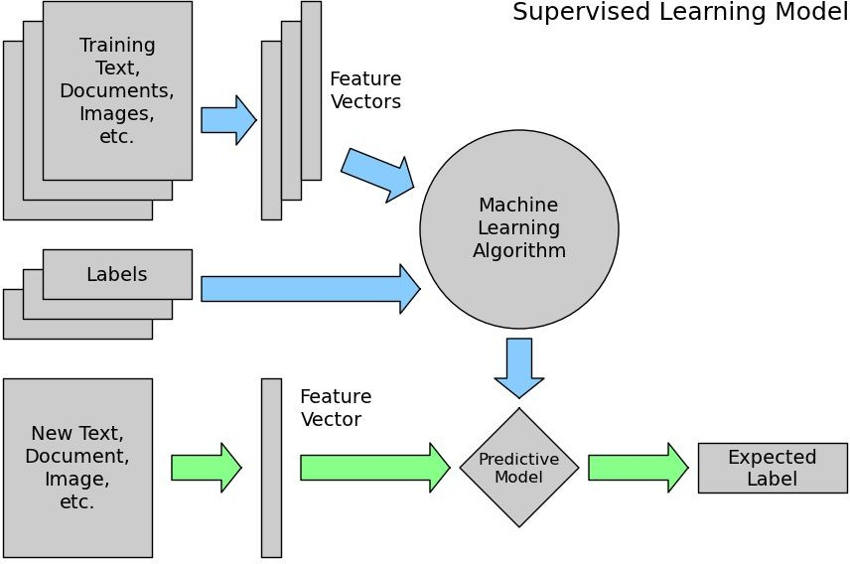

Slide 11
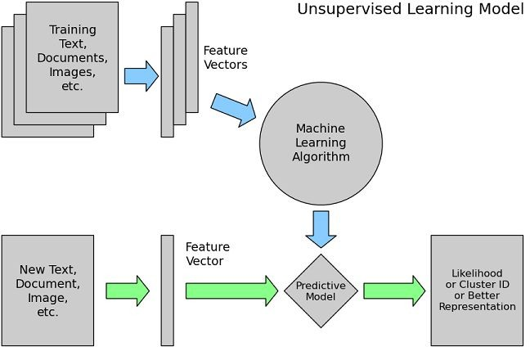

Slide 12
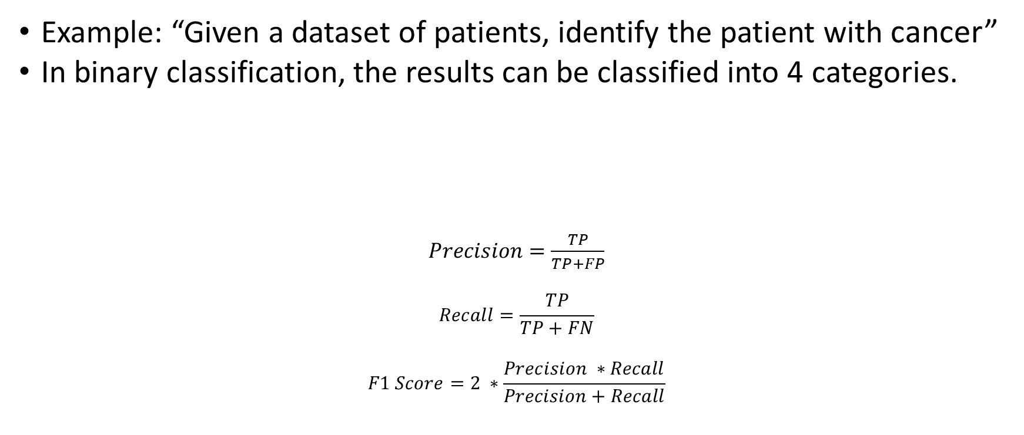
Evaluating a Model
Example: “Given a dataset of patients, identify the patient with cancer”
In binary classification, the results can be classified into 4 categories.
$Precision=\frac{TP}{TP+FP}$
$$Recall=\frac{TP}{TP+FN}$$
$$F1 Score=2 ∗\frac{Precision ∗Recall}{Precision+Recall}$$
True Positives No. of results which correctly identified the patients with cancer | True Negatives No. of results which correctly identified the patients without cancer
False Positives No. of results which identified healthy patients as having cancer | False Negatives No. of results which identified cancer patients as healthy

Slide 13
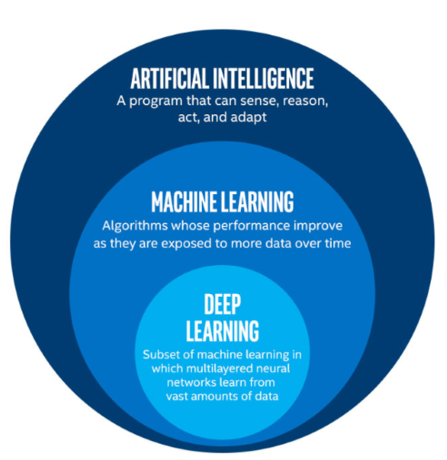
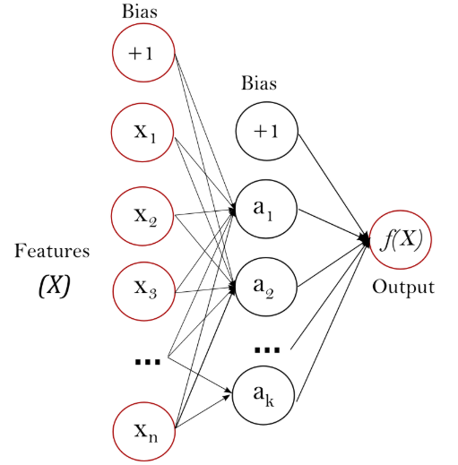
Deep Learning and Neural Networks
Subfield of Machine Learning which uses Artificial Neural Networks.

Slide 14
Computer Vision
Machine’s ability to perceive and understand the data available as images and videos
Applications
Facial Recognition
Optical Character Recognition
Self-Driving Cars
Healthcare
Robotics

Slide 15
Computer Vision – Image Processing
Denoising
Reduces the noise caused by factors such as low light, shaky captures.
Thresholding
Converts an image into a binary image with only 2 pixel densities.
Transforming
Updating the dimensions, scale, rotation, skew of an image to maintain uniformity across all the training images.

Slide 16
Natural Language Processing
Machine’s ability to understand human language via speech and text.
Applications
Virtual Assistants
Spam filtering
Language Translation
Predictive Text
Enhanced Search Engines

Slide 17
Natural Language Processing
Tokenization
Split the text into separate tokens.
Stemming
Remove any affixes in a word.
For example, “Flowers” to “Flower”, “Playing” to “Play”
Lemmatization
Transform a word to the base or dictionary form of the word.
For example, “seen” to “see”.
Remove Stop Words to reduce noise
The word “the” may appear a lot of times in a document.

Slide 18
Natural Language Processing
Vectorization – Processing textual features into numerical features.
Bag of Words - A technique to represent text as a bag of words.
TF-IDF – Term frequency-inverse document frequency
Penalizes words which common across all the training documents
Word2Vec
Deep learning technique developed at Google.

Slide 19
Thank You

